Slide 1

Water Tower for Gadhyampurva, India
Replace bore wells with AguaClara, village-sized water treatment tower to provide Gadhyampurva, India with clean drinking water.
Notes:
10 minute presentation (3 min background, 3 min design process, 2 min conclusion, 1 min questions)

Slide 2
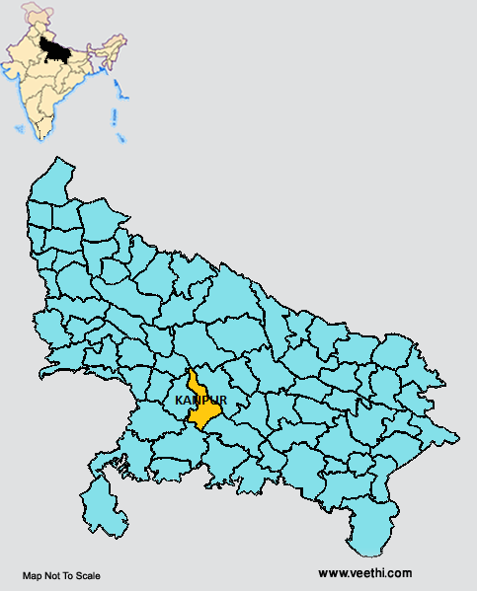
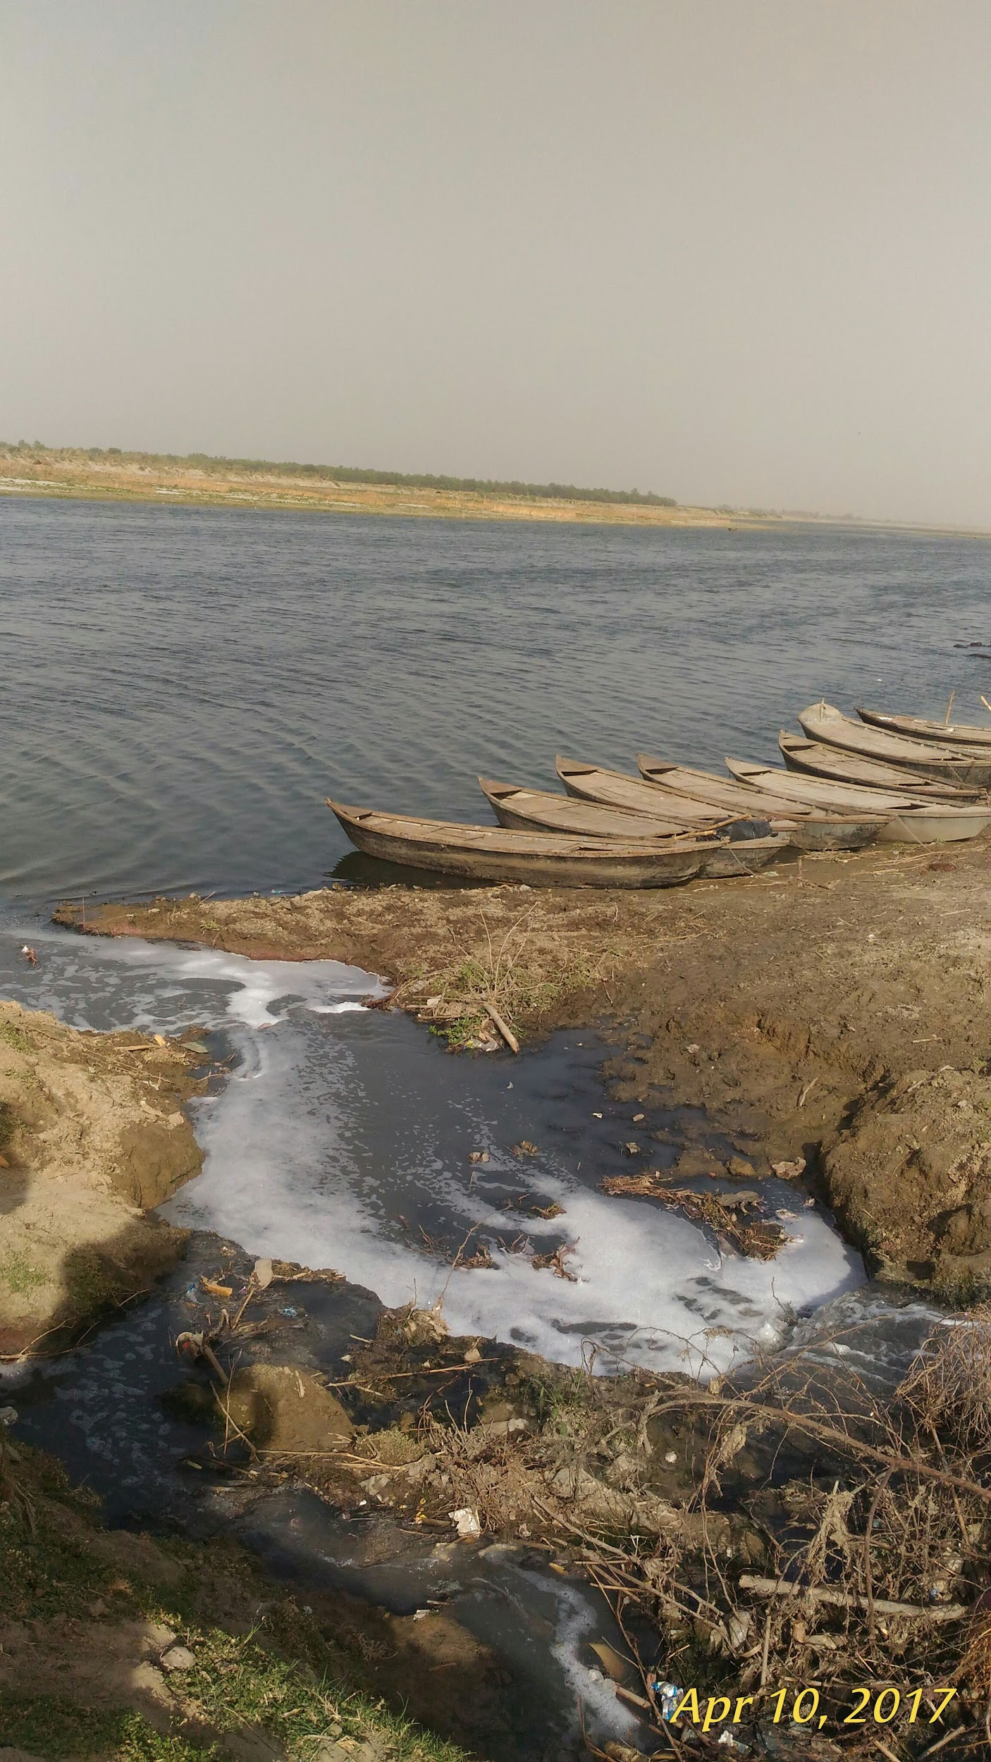
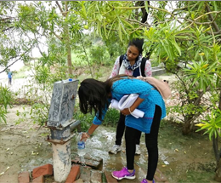
Village of Gadhyampurva does not have water treatment system
Location
Kanpur, Uttar Pradesh, India
Water Source
Reliant on untreated groundwater
Waterborne illnesses
Notes:
The purpose of this project is to design a customized water treatment plant for a small size village in Northern part of India for providing water on tap in 70 households.
Cite your sources here.
The village of Gadhyampurva is situated in the Aima Panchayat in the Kanpur Nagar District of Uttar Pradesh in India. Kanpur Nagar is one of the highly urbanized and industrialized area of the Ganga river basin. It is approximately 7 km downstream of the Common Effluent Treatment Plant (CETP) in Kanpur.It depends primarily on groundwater for both irrigation and household consumption, including water use for cattle and livestock. The main diseases prevalent in the village are Diarrhea, Cholera, and vector borne diseases like Malaria.
If there are any appendix slides that are relevant to this slide, mention it in your notes.

Slide 3
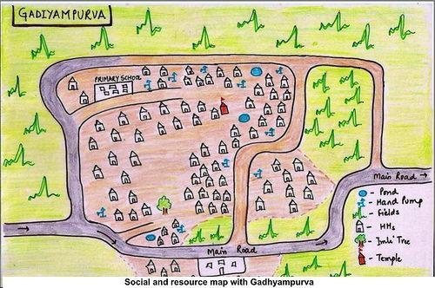
Gadhyampurva should use an AguaClara water tower
Groundwater has low turbidity
Small sized community- 70 households
Space available for installing the plant
Community based treatment technology available with AguaClara
Enable easy access to good quality water
Notes:
The village has a population of approximately 400 people living in 70 houses with an average of 6 members per household. AguaClara, a multi-disciplinary program at Cornell University has been working on designing low-cost gravity-powered sustainable water treatment systems for under-served communities around the world.
Caption your figure and explain its relevance to your presentation/thesis here. You can take the caption from your Final Report and modify it.
Write a summary of this slide here. A future team member or client should be able to read this note and understand this slide without having your team explain it to them.
If there are any appendix slides that are relevant to this slide, mention it in your notes.

Slide 4
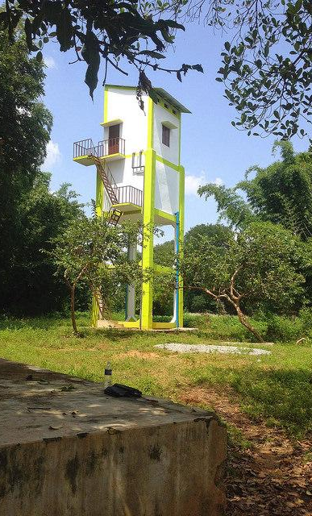
Water towers for treating groundwater have been built in India
Use of simple, sustainable water disinfection technology- the Hydrodoser
Treats shallow well water - turbidity below 5 NTU
Solar powered
1 liters/ sec plants- able to provide 70 lpcd
Charges- USD 1 per household per month
Community Managed
SIMPLE
LOCAL
AFFORDABLE
SUSTAINABLE
Notes:
Based on 15 years of experience from field trials in Honduras and further design tailoring for 4 different villages in India, AguaClara have developed a simple, sustainable water disinfection technology: the Hydrodoser. This easy-to-install system was designed specifically to treat shallow well water, a common water source for many Indian villages. The Hydrodoser is a hydraulic chlorine delivery system that is low-maintenance and high-performing. It automatically turns on and off with the flow of raw water, and automatically adjusts to changes in raw water flow rate to always deliver the correct dose. This solution avoids the risks of dangerous overdosing or underdosing posed by inaccurate chlorine drip methods, and eliminates parts prone to failure found in high-tech pump-based and sensor-based technologies. The Hydrodoser is well-suited to handle the fluctuating flows delivered by solar pumps.
Furthermore, it is affordable in base of the pyramid communities. For 1 USD per household per month, the Hydrodoser can provide each individual in a community of 500 people 70 liters of safe drinking water on tap per day. The Hydrodoser is made of locally-available materials, such as PVC, plastic tubing, simple pipe fittings, and HDPE drums. The system is intuitive, modular, and open-source, facilitating in-depth training of local operators, who can then easily take apart components for repair, replacement, or basic troubleshooting. Thus, the expected system lifetime is 20 years or more.
Write a summary of this slide here. A future team member or client should be able to read this note and understand this slide without having your team explain it to them.
If there are any appendix slides that are relevant to this slide, mention it in your notes.

Slide 5
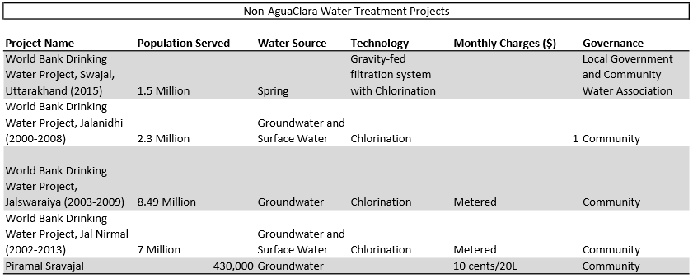
AguaClara technology is a better option than current technology in India
Notes:
Other water treatment projects in India have been much larger and are not suitable for small villages. Additionally, it is hard to get reliable information on the water quality of the effluent water.
Previous AguaClara plants in India have proven to be very reliable and high performing. There is greater reliability and clarity surrounding AguaClara plants.

Slide 6
To meet the daily water, the village required two 1 L/s filters running 6 hr/day.
Home Use
Community
43000L/day
.5 L/s
2 L/s for 6 hrs
70 Households
6 people per Household
Requirement = 100 L/person/day
1000 L/day
43000 L/day
Notes:
Community Water needs total 43000 L/day for the community needs. The number of people, livestock, and community buildings provide a total water need. Additionally, the estimate of water needs per day for one person is 100 L/day.

Slide 7
The stages of designing for Gadhyampurva
Evaluate Need
Consult Existing Projects
Customize for Gahyampurva
Notes:
Analysis and Methods
The methods for designing the plant for Gadhyampurva stemmed from evaluating the need in the community. There is currently no source of safe drinking water in the community, and the available surface water is far too contaminated to be considered for drinking water. The village currently relies on groundwater for their drinking water.
We then considered the current projects in India to see what would be possible for Gadhyampurva. AguaClara’s involvement in India so far has been with water towers that provide filtration and disinfection for groundwater. This seemed like the best option for Gadhyampurva.
We based our design on the current filtration towers that AguaClara has built in India and focused on filtration and disinfection, considering that the groundwater has low turbidity (not measured because it was very low). We continued to make design assumptions and specifications based on our data about Gadhyampurva. However, considering that we did not have enough data, the design team would need to return to the “evaluate needs” stage before further progress could be made on the plant.

Slide 8
Design development and customization
Going Beyond Standardization
- Coagulant Dosing
- Tower Design
- Storage Options
Notes:
Significant findings from your design development
Ultimately our design is incomplete because of the many unknowns about Gadhyampurva, but we were able to lay the groundwork for the creation of the treatment tower in the village. The majority of the design work was based on previous work in design challenges and existing AguaClara technology, a lot of which is standardized - 1L/s StaRS filters, dosing systems, etc. However, in developing the design, there were variables that needed to be determined beyond the standardized methods. Some of these included the coagulant dosing, the height of the tower, and the storage options. The coagulant dosing we designed for was based on historical dosing in low turbidity plants in Honduras. In order to get a better idea of the dosing, a jar test could be conducted, although jar tests are more representative of floc/sed/filter plants than simply filtration plants. The tower design is dependent upon the location of the tower because the height is determined by the maximum head drop between the tower and the highest building in the village. Finally, the storage options depend greatly on the possibility of individual storage tanks at each household as well as the capacity of the tower, all of which depends greatly on the specifics of Gadhyampurva.

Slide 9
Treatment train uses coagulant dosing, filtration, and disinfection.
Coagulant Dosing
Filtration
Disinfection
Granular PACl will be used
Stock = 100 mg/L
Turbidity in Gadhyampurva
< 10 NTU
Coagulant dosing in Honduras
5 NTU < Turbidity < 10 NTU
3 mg/L < Coagulant < 6 mg/L
Dosing in Gadhyampurva
5 mg/L
4 dosing tubes
Two 1L/s EStARS Filters
Total flow = 2L/s
Running 6 hr/day
Standardized StaRS model
Safety factor = 1.1
Equivalent to a 15cm safety factor during backwash
Chlorine bleach will be used
Stock = 51.4 g/L
Standard dosing
2 - 4 mg/L
1 dosing tube
Notes:
Sources:
AguClara GitHub, 2017. POST, Datos Sobre la Planta de Matias. Available at: http://aguaclara.github.io/index.html [Accessed December 1, 2017].
Also used Monroe’s slides and DCs for references for design.
Treatment Train
The designed treatment train for this plant uses coagulant dosing, filtration, and disinfection.
At this time, we do not have any data on the turbidity of the groundwater. Also, it is impossible to know which coagulant will be the best choice for Gahyampurva, but granular PACl is easier to work with and is being used in the majority of plants. The dosing was determined based on the lower turbidity plants in Honduras.
Two StARS filters will be used, making the total capacity 2L/s as mentioned before. The design specifications were based on the standardized StARS model, including a safety factor of 1.1, which is equivalent to a 15cm safety factor during backwash.
The disinfection stage was designed for use with chlorine bleach. The dose was determined based on standards. For both dosing systems (coagulant and disinfection), an additional dosing tube would be added to facilitate maintenance.

Slide 10
Future Tasks
Finalising the design after in-depth interview with the community, village head and local government
Budgeting of the project
Fundraising for project execution
Project Implementation
Monitoring and Evaluation
Design improvement - addressing the problem of fluoride
Rainwater Harvesting for recharging groundwater
Notes:
Moving forward with the project in Gahyampurva

Slide 11
References
Agnihotri, N. et al., 2014. Hydrochemical Assessment and Factor Analysis of Groundwater with Special Reference to Fluoride in. IOSR Journal of Applied Chemistry Ver. I, 7(3), pp.52–56. Available at: www.iosrjournals.org [Accessed November 28, 2017].
Agrawal, N., Singh, R. & Chaubey, P.M., 2007. Assessment of Ground Water Toxicity Due to Tannery Industry at Jajmau, Kanpur (UP). International Journal of Innovative Research in Science, Engineering and Technology (An ISO Certified Organization), 3297(3). Available at: https://www.ijirset.com/upload/2016/march/196_45_Assessment.pdf [Accessed November 27, 2017].
AguClara GitHub, 2017. POST, Datos Sobre la Planta de Matias. Available at: http://aguaclara.github.io/index.html [Accessed December 1, 2017].
Ahmad, S. & Mishra, A., 2014. A Study on Physico-Chemical Properties of Ground Water Quality of Various Locations of Kanpur City. International Journal of Science and Research, 3(3). Available at: https://www.ijsr.net/archive/v3i3/MDIwMTMxMDU3.pdf [Accessed November 27, 2017].
Bureau of Indian Standards, 2012. Indian Standard -Drinking Water Specification, Available at: http://cgwb.gov.in/Documents/WQ-standards.pdf.
Bank, T.W., 2010. India - Maharashtra Rural Water Supply and Sanitation. , pp.1–77. Available at: http://documents.worldbank.org/curated/en/692411468284123478/India-Maharashtra-Rural-Water-Supply-and-Sanitation-Jalswarajya-Project [Accessed November 30, 2017].
Billions in Change, Water - Billions in Change. Available at: https://billionsinchange.com/solutions/water/ [Accessed November 30, 2017].
Central Pollution Control Board, 2016. A Report on GANGA MATTERS (Uttarakhand and Uttar Pradesh), Available at: http://cpcb.nic.in/Report_on_Ganga_Matter_of_Uttarakhand_and_Uttar Pradesh.pdf [Accessed November 30, 2017].
Charity Water, Clean Water Projects in India | charity: water. Available at: https://www.charitywater.org/our-projects/asia/india [Accessed November 30, 2017].
Jal Nirmal, Jal Nirmal Project boon to Gulbarga, Yadgir districts - KARNATAKA - The Hindu. Available at: http://www.thehindu.com/todays-paper/tp-national/tp-karnataka/jal-nirmal-project-boon-to-gulbarga-yadgir-districts/article3538444.ece [Accessed November 30, 2017].
Piramal Foundation, Piramal Sarvajal. Available at: http://www.sarvajal.com/water-atm.php [Accessed November 30, 2017].
Planning Commission, 2006. :::Comprehensive District Agriculture Plan(C-DAP)::: Available at: http://www.rkvy.nic.in/static/c-dap-annexure-iframe.html [Accessed November 30, 2017].
The Engineering ToolBox, 2017. Ventilation Ducts - Roughness and Surface Coefficients. Available at: https://www.engineeringtoolbox.com/surface-roughness-ventilation-ducts-d_209.html
The World Bank, Projects : IN 2nd Kerala Rural Water Supply and Sanitation Project (Jalanidhi II) | The World Bank. Available at: http://projects.worldbank.org/P121774/second-kerala-rural-water-supply-sanitation-project-jalanidhi-ii?lang=en&tab=overview [Accessed November 30, 2017].
Tripathi, P.K., 2008. District Brochure of Kanpur Nagar District, U P, Available at: http://www.cgwb.gov.in/District_Profile/UP/Kanpur Nagar.pdf [Accessed November 30, 2017].
World Bank, 2016. India: Bringing Clean Drinking Water to India’s Villages. Available at: http://www.worldbank.org/en/results/2016/05/24/bringing-clean-water-india-villages [Accessed November 30, 2017].
Notes:
References Slide

Slide 12
Questions
and
Recommendations
Adriana Guzman
Biological Engineering’18
aig36@cornell.edu
Natalie Mottl
Civil Engineering ‘18
nlm42@cornell.edu
Fawzia Tarannum
Hubert H Humphrey Fellow
ft227@cornell.edu
Notes:
Questions and recommendations

Slide 13
Appendix
Slides
Notes:
Appendix

Slide 14
Water Quality Parameter results for Groundwater from 36m depth:
Sample | pH | E.CmS | Acidity mg/l | Alkalinity mg/L | Nitrate mg/L | Chloride mg/L | Sulphate (mg/L) | Fluoride (mg/L) | Iron (mg/l) | T.D.S. mg/L) | T. S. mg/L)
Garadyampurva(Hand pump) 27/5/2017 | 7.19 | 0.8 | 55 | 435 | 0.41 | 69.97 | 14.51 | 1.29 | - | 944 | 1047
Drinking Standard BIS) | 6.5-8.5 | - | - | 200 | 45 | 250 | 200 | 1.0 | 0.3 | 500 | -
Permissible Limit (BIS) | No Relaxation | - | - | 600 | No relaxation | 1000 | 400 | 1.5 | No relaxation | - | -
Notes:
Water quality of groundwater from 36m down.

Slide 15
Gahyampurva has various water sources
GADHYAMPURVA GROUND WATER
Sources | Number | Depth
Hand pump | 20-25 | 36m
Bore well | 6-7 | 55m
Well | 3 | 46m-91m
Ponds | 2 | 4.5-6 m, 9-12m
Notes:
Water sources in Gahyampurva

